Slide 1

Introduction to Database
Management Trainee 2023

Slide 2

What is Database
The database is a collection of inter-related data which is used to retrieve, insert and delete the data efficiently. It is also used to organize the data in the form of a table, schema, views, and reports, etc.
For example: The college Database organizes the data about the admin, staff, students and faculty etc.
Using the database, you can easily retrieve, insert, and delete the information.

Slide 3

Database Management System
Database management system is a software which is used to manage the database. For example: MySQL, Oracle, etc. are a very popular commercial database which is used in different applications.
DBMS provides an interface to perform various operations like database creation, storing data in it, updating data, creating a table in the database and a lot more.
It provides protection and security to the database. In the case of multiple users, it also maintains data consistency.

Slide 4
DBMS allows users the following tasks:
Data Definition: It is used for creation, modification, and removal of definition that defines the organization of data in the database.
Data Updation: It is used for the insertion, modification, and deletion of the actual data in the database.
Data Retrieval: It is used to retrieve the data from the database which can be used by applications for various purposes.
User Administration: It is used for registering and monitoring users, maintain data integrity, enforcing data security, dealing with concurrency control, monitoring performance and recovering information corrupted by unexpected failure.

Slide 5
Characteristics of DBMS
It uses a digital repository established on a server to store and manage the information.
It can provide a clear and logical view of the process that manipulates data.
DBMS contains automatic backup and recovery procedures.
It contains ACID properties which maintain data in a healthy state in case of failure.
It can reduce the complex relationship between data.
It is used to support manipulation and processing of data.
It is used to provide security of data.
It can view the database from different viewpoints according to the requirements of the user.

Slide 6
Advantages of DBMS
Controls database redundancy: It can control data redundancy because it stores all the data in one single database file and that recorded data is placed in the database.
Data sharing: In DBMS, the authorized users of an organization can share the data among multiple users.
Easily Maintenance: It can be easily maintainable due to the centralized nature of the database system.
Reduce time: It reduces development time and maintenance need.
Backup: It provides backup and recovery subsystems which create automatic backup of data from hardware and software failures and restores the data if required.
multiple user interface: It provides different types of user interfaces like graphical user interfaces, application program interfaces

Slide 7
Disadvantages of DBMS
Cost of Hardware and Software: It requires a high speed of data processor and large memory size to run DBMS software.
Size: It occupies a large space of disks and large memory to run them efficiently.
Complexity: Database system creates additional complexity and requirements.
Higher impact of failure: Failure is highly impacted the database because in most of the organization, all the data stored in a single database and if the database is damaged due to electric failure or database corruption then the data may be lost forever.

Slide 8
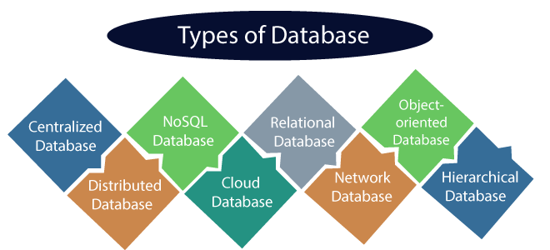
Types of Databases
There are various types of databases used for storing different varieties of data:

Slide 9

Centralized Database
It is the type of database that stores data at a centralized database system. It comforts the users to access the stored data from different locations through several applications. These applications contain the authentication process to let users access data securely. An example of a Centralized database can be Central Library that carries a central database of each library in a college/university.
Advantages of Centralized Database
It has decreased the risk of data management, i.e., manipulation of data will not affect the core data.
Data consistency is maintained as it manages data in a central repository.
It provides better data quality, which enables organizations to establish data standards.
It is less costly because fewer vendors are required to handle the data sets.

Slide 10
Centralized Database
Disadvantages of Centralized Database
The size of the centralized database is large, which increases the response time for fetching the data.
It is not easy to update such an extensive database system.
If any server failure occurs, entire data will be lost, which could be a huge loss.

Slide 11
Distributed Database
Unlike a centralized database system, in distributed systems, data is distributed among different database systems of an organization. These database systems are connected via communication links. Such links help the end-users to access the data easily. Examples of the Distributed database are Apache Cassandra, HBase, Ignite, etc.
We can further divide a distributed database system into:
Homogeneous DDB: Those database systems which execute on the same operating system and use the same application process and carry the same hardware devices.
Heterogeneous DDB: Those database systems which execute on different operating systems under different application procedures and carries different hardware devices.

Slide 12

Advantages of Distributed Database
Modular development is possible in a distributed database, i.e., the system can be expanded by including new computers and connecting them to the distributed system.
One server failure will not affect the entire data set.

Slide 13
Relational Database
This database is based on the relational data model, which stores data in the form of rows(tuple) and columns(attributes), and together forms a table(relation). A relational database uses SQL for storing, manipulating, as well as maintaining the data. E.F. Codd invented the database in 1970. Each table in the database carries a key that makes the data unique from others. Examples of Relational databases are MySQL, Microsoft SQL Server, Oracle, etc.
Properties of Relational Database
There are following four commonly known properties of a relational model known as ACID properties, where:
A means Atomicity: This ensures the data operation will complete either with success or with failure. It follows the 'all or nothing' strategy. For example, a transaction will either be committed or will abort.
C means Consistency: If we perform any operation over the data, its value before and after the operation should be preserved. For example, the account balance before and after the transaction should be correct, i.e., it should remain conserved.

Slide 14
Relational Database
I means Isolation: There can be concurrent users for accessing data at the same time from the database. Thus, isolation between the data should remain isolated. For example, when multiple transactions occur at the same time, one transaction effects should not be visible to the other transactions in the database.
D means Durability: It ensures that once it completes the operation and commits the data, data changes should remain permanent.

Slide 15

Cloud Database
A type of database where data is stored in a virtual environment and executes over the cloud computing platform. It provides users with various cloud computing services (SaaS, PaaS, IaaS, etc.) for accessing the database. There are numerous cloud platforms, but the best options are:
Amazon Web Services(AWS)
Microsoft Azure
Kamatera
PhonixNAP
ScienceSoft
Google Cloud SQL, etc.

Slide 16

NoSQL Database
Non-SQL/Not Only SQL is a type of database that is used for storing a wide range of data sets. It is not a relational database as it stores data not only in tabular form but in several different ways. It came into existence when the demand for building modern applications increased. Thus, NoSQL presented a wide variety of database technologies in response to the demands.

Slide 17
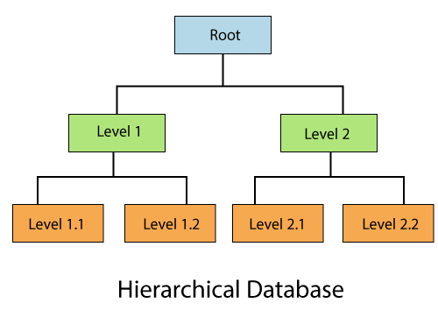
Hierarchical Databases
It is the type of database that stores data in the form of parent-children relationship nodes. Here, it organizes data in a tree-like structure.

Slide 18
Network Databases
It is the database that typically follows the network data model. Here, the representation of data is in the form of nodes connected via links between them.
Unlike the hierarchical database, it allows each record to have multiple children and parent nodes to form a generalized graph structure.

Slide 19
Personal Database
Collecting and storing data on the user's system defines a Personal Database. This database is basically designed for a single user.
Advantage of Personal Database
It is simple and easy to handle.
It occupies less storage space as it is small in size.

Slide 20
Operational and Enterprise Database
Operational database which creates and updates the database in real-time. It is basically designed for executing and handling the daily data operations in several businesses. For example, An organization uses operational databases for managing per day transactions.
Enterprise Database Large organizations or enterprises use this database for managing a massive amount of data. It helps organizations to increase and improve their efficiency. Such a database allows simultaneous access to users.
Advantages of Enterprise Database:
Multi processes are supportable over the Enterprise database.
It allows executing parallel queries on the system.

Slide 21
Relational Model in DBMS
Relational model can represent as a table with columns and rows. Each row is known as a tuple. Each table of the column has a name or attribute.
Domain: It contains a set of atomic values that an attribute can take.
Attribute: It contains the name of a column in a particular table. Each attribute Ai must have a domain, dom(Ai)
Relational instance: In the relational database system, the relational instance is represented by a finite set of tuples. Relation instances do not have duplicate tuples.
Relational schema: A relational schema contains the name of the relation and name of all columns or attributes.
Relational key: In the relational key, each row has one or more attributes. It can identify the row in the relation uniquely.

Slide 22
Example: STUDENT Relation
NAME | ROLL_NO | PHONE_NO | ADDRESS | AGE
Ram | 14795 | 7305758992 | Noida | 24
Shyam | 12839 | 9026288936 | Delhi | 35
Laxman | 33289 | 8583287182 | Gurugram | 20
Mahesh | 27857 | 7086819134 | Ghaziabad | 27
Ganesh | 17282 | 9028 9i3988 | Delhi | 40
In the given table, NAME, ROLL_NO, PHONE_NO, ADDRESS, and AGE are the attributes.
The instance of schema STUDENT has 5 tuples.
t3 = <Laxman, 33289, 8583287182, Gurugram, 20>

Slide 23
Properties of Relations
Name of the relation is distinct from all other relations.
Each relation cell contains exactly one atomic (single) value
Each attribute contains a distinct name
Attribute domain has no significance
tuple has no duplicate value
Order of tuple can have a different sequence

Slide 24
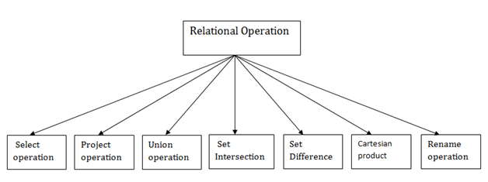
Relational Algebra
Relational algebra is a procedural query language. It gives a step-by-step process to obtain the result of the query. It uses operators to perform queries.
Types of Relational operation

Slide 25
1. Select Operation:
The select operation selects tuples that satisfy a given predicate.
It is denoted by sigma (σ).
Notation: σ p(r)
Where:
σ is used for selection prediction
r is used for relation
p is used as a propositional logic formula which may use connectors like: AND OR and NOT. These relational can use as relational operators like =, ≠, ≥, <, >, ≤.

Slide 26
For example: LOAN Relation
BRANCH_NAME | LOAN_NO | AMOUNT
Downtown | L-17 | 1000
Redwood | L-23 | 2000
Perryride | L-15 | 1500
Downtown | L-14 | 1500
Mianus | L-13 | 500
Roundhill | L-11 | 900
Perryride | L-16 | 1300

Slide 27
Input:
σ BRANCH_NAME="perryride" (LOAN)
Output:
BRANCH_NAME | LOAN_NO | AMOUNT
Perryride | L-15 | 1500
Perryride | L-16 | 1300

Slide 28
2. Project Operation:
This operation shows the list of those attributes that we wish to appear in the result. Rest of the attributes are eliminated from the table.
It is denoted by ∏.
Notation: ∏ A1, A2, An (r)
Where: A1, A2, A3 is used as an attribute name of relation r.

Slide 29
Example: CUSTOMER RELATION
NAME | STREET | CITY
Jones | Main | Harrison
Smith | North | Rye
Hays | Main | Harrison
Curry | North | Rye
Johnson | Alma | Brooklyn
Brooks | Senator | Brooklyn

Slide 30
Input:
∏ NAME, CITY (CUSTOMER)
Output:
NAME | CITY
Jones | Harrison
Smith | Rye
Hays | Harrison
Curry | Rye
Johnson | Brooklyn
Brooks | Brooklyn

Slide 31
3. Union Operation:
Suppose there are two tuples R and S. The union operation contains all the tuples that are either in R or S or both in R & S.
It eliminates the duplicate tuples. It is denoted by ∪.
Notation: R ∪ S
A union operation must hold the following condition:
R and S must have the attribute of the same number.
Duplicate tuples are eliminated automatically.

Slide 32
Example:
DEPOSITOR RELATION
CUSTOMER_NAME | ACCOUNT_NO
Johnson | A-101
Smith | A-121
Mayes | A-321
Turner | A-176
Johnson | A-273
Jones | A-472
Lindsay | A-284

Slide 33
BORROW RELATION
CUSTOMER_NAME | LOAN_NO
Jones | L-17
Smith | L-23
Hayes | L-15
Jackson | L-14
Curry | L-93
Smith | L-11
Williams | L-17

Slide 34
Input:
∏ CUSTOMER_NAME (BORROW) ∪ ∏ CUSTOMER_NAME (DEPOSITOR)
Output:
CUSTOMER_NAME
Johnson
Smith
Hayes
Turner
Jones
Lindsay
Jackson
Curry
Williams
Mayes

Slide 35
4. Set Intersection:
Suppose there are two tuples R and S. The set intersection operation contains all tuples that are in both R & S.
It is denoted by intersection ∩.
Notation: R ∩ S
Example: Using the above DEPOSITOR table and BORROW table
Input:
∏ CUSTOMER_NAME (BORROW) ∩ ∏ CUSTOMER_NAME (DEPOSITOR)

Slide 36
Output:
CUSTOMER_NAME
Smith
Jones

Slide 37
5. Set Difference:
Suppose there are two tuples R and S. The set intersection operation contains all tuples that are in R but not in S.
It is denoted by intersection minus (-).
Notation: R - S
Example: Using the above DEPOSITOR table and BORROW table
Input:
∏ CUSTOMER_NAME (BORROW) - ∏ CUSTOMER_NAME (DEPOSITOR)

Slide 38
Output:
CUSTOMER_NAME
Jackson
Hayes
Willians
Curry

Slide 39
6. Cartesian product
EMP_ID | EMP_NAME | EMP_DEPT
1 | Smith | A
2 | Harry | C
3 | John | B
The Cartesian product is used to combine each row in one table with each row in the other table. It is also known as a cross product.
It is denoted by X.
Notation: E X D
Example: EMPLOYEE Table

Slide 40
DEPARTMENT
DEPT_NO | DEPT_NAME
A | Marketing
B | Sales
C | Legal
Example: Department Table

Slide 41
Input: EMPLOYEE X DEPARTMENT
EMP_ID | EMP_NAME | EMP_DEPT | DEPT_NO | DEPT_NAME
1 | Smith | A | A | Marketing
1 | Smith | A | B | Sales
1 | Smith | A | C | Legal
2 | Harry | C | A | Marketing
2 | Harry | C | B | Sales
2 | Harry | C | C | Legal
3 | John | B | A | Marketing
3 | John | B | B | Sales
3 | John | B | C | Legal
Output:

Slide 42

7. Rename Operation:
The rename operation is used to rename the output relation. It is denoted by rho (ρ).
Example: We can use the rename operator to rename STUDENT relation to STUDENT1.
ρ(STUDENT1, STUDENT)

Slide 43
Join Operations:
A Join operation combines related tuples from different relations, if and only if a given join condition is satisfied. It is denoted by ⋈.
Example: EMPLOYEE
Example: SALARY
EMP_CODE | EMP_NAME
101 | Stephan
102 | Jack
103 | Harry
EMP_CODE | SALARY
101 | 50000
102 | 30000
103 | 25000

Slide 44
Operation:
(EMPLOYEE ⋈ SALARY)
Result:
EMP_CODE | EMP_NAME | SALARY
101 | Stephan | 50000
102 | Jack | 30000
103 | Harry | 25000

Slide 45
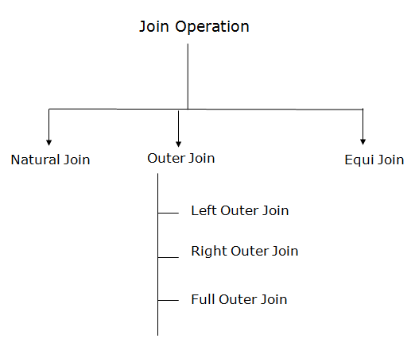
Types of Join operations:

Slide 46
1. Natural Join:
Output:
A natural join is the set of tuples of all combinations in R and S that are equal on their common attribute names.
It is denoted by ⋈.
Example: Let's use the above EMPLOYEE table and SALARY table:
Input:
∏EMP_NAME, SALARY (EMPLOYEE ⋈ SALARY)
EMP_NAME | SALARY
Stephan | 50000
Jack | 30000
Harry | 25000

Slide 47
2. Outer Join:
The outer join operation is an extension of the join operation. It is used to deal with missing information.
Example: EMPLOYEE
FACT_WORKERS
EMP_NAME | STREET | CITY
Ram | Civil line | Mumbai
Shyam | Park street | Kolkata
Ravi | M.G. Street | Delhi
Hari | Nehru nagar | Hyderabad
EMP_NAME | BRANCH | SALARY
Ram | Infosys | 10000
Shyam | Wipro | 20000
Kuber | HCL | 30000
Hari | TCS | 50000

Slide 48
Input:
(EMPLOYEE ⋈ FACT_WORKERS)
Output:
EMP_NAME | STREET | CITY | BRANCH | SALARY
Ram | Civil line | Mumbai | Infosys | 10000
Shyam | Park street | Kolkata | Wipro | 20000
Hari | Nehru nagar | Hyderabad | TCS | 50000

Slide 49
An outer join is basically of three types:
Left outer join, b. Right outer join, c. Full outer join
Left outer join:
Left outer join contains the set of tuples of all combinations in R and S that are equal on their common attribute names.
In the left outer join, tuples in R have no matching tuples in S.
It is denoted by ⟕.

Slide 50
Example: Using the above EMPLOYEE table and FACT_WORKERS table
EMP_NAME | STREET | CITY | BRANCH | SALARY
Ram | Civil line | Mumbai | Infosys | 10000
Shyam | Park street | Kolkata | Wipro | 20000
Hari | Nehru street | Hyderabad | TCS | 50000
Ravi | M.G. Street | Delhi | NULL | NULL
Input: EMPLOYEE ⟕ FACT_WORKERS

Slide 51
Right outer join:
Output:
EMP_NAME | BRANCH | SALARY | STREET | CITY
Ram | Infosys | 10000 | Civil line | Mumbai
Shyam | Wipro | 20000 | Park street | Kolkata
Hari | TCS | 50000 | Nehru street | Hyderabad
Kuber | HCL | 30000 | NULL | NULL
Right outer join contains the set of tuples of all combinations in R and S that are equal on their common attribute names.
In right outer join, tuples in S have no matching tuples in R.
It is denoted by ⟖.
Example: Using the above EMPLOYEE table and FACT_WORKERS Relation
Input: EMPLOYEE ⟖ FACT_WORKERS

Slide 52
Full outer join:
Output:
EMP_NAME | STREET | CITY | BRANCH | SALARY
Ram | Civil line | Mumbai | Infosys | 10000
Shyam | Park street | Kolkata | Wipro | 20000
Hari | Nehru street | Hyderabad | TCS | 50000
Ravi | M.G. Street | Delhi | NULL | NULL
Kuber | NULL | NULL | HCL | 30000
Full outer join is like a left or right join except that it contains all rows from both tables.
In full outer join, tuples in R that have no matching tuples in S and tuples in S that have no matching tuples in R in their common attribute name.
It is denoted by ⟗.
Example: Using the above EMPLOYEE table and FACT_WORKERS table
Input: EMPLOYEE ⟗ FACT_WORKERS

Slide 53
Equi join:
It is also known as an inner join. It is the most common join. It is based on matched data as per the equality condition. The equi join uses the comparison operator(=).
Example:
CUSTOMER RELATION
PRODUCT
CLASS_ID | NAME
1 | John
2 | Harry
3 | Jackson
PRODUCT_ID | CITY
1 | Delhi
2 | Mumbai
3 | Noida

Slide 54
Input: CUSTOMER ⋈ PRODUCT
Output:
CLASS_ID | NAME | PRODUCT_ID | CITY
1 | John | 1 | Delhi
2 | Harry | 2 | Mumbai
3 | Harry | 3 | Noida

Slide 55
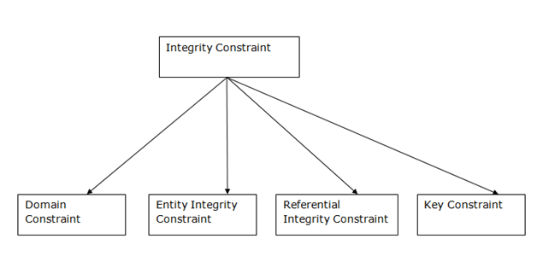
Integrity Constraints
Integrity constraints are a set of rules. It is used to maintain the quality of information.
Integrity constraints ensure that the data insertion, updating, and other processes have to be performed in such a way that data integrity is not affected.
Thus, integrity constraint is used to guard against accidental damage to the database.
Types of Integrity Constraint

Slide 56
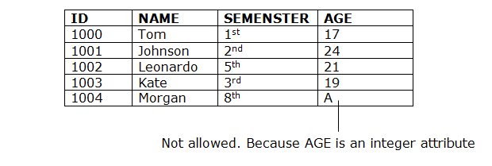
Domain constraints
Domain constraints can be defined as the definition of a valid set of values for an attribute.
The data type of domain includes string, character, integer, time, date, currency, etc. The value of the attribute must be available in the corresponding domain.
Example:

Slide 57
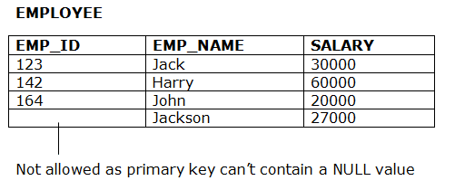
Entity integrity constraints
The entity integrity constraint states that primary key value can't be null.
This is because the primary key value is used to identify individual rows in relation and if the primary key has a null value, then we can't identify those rows.
A table can contain a null value other than the primary key field.
Example:

Slide 58
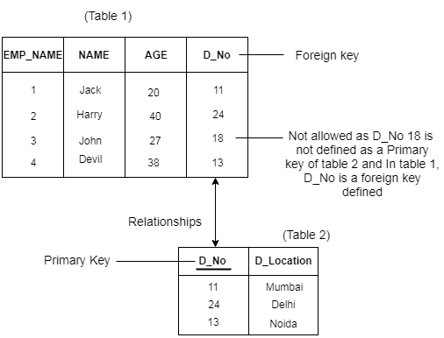
Referential Integrity Constraints
A referential integrity constraint is specified between two tables.
In the Referential integrity constraints, if a foreign key in Table 1 refers to the Primary Key of Table 2, then every value of the Foreign Key in Table 1 must be null or be available in Table 2.
Example:

Slide 59
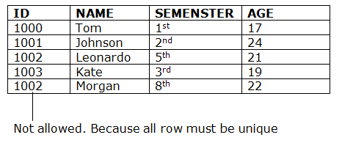
Key constraints
Keys are the entity set that is used to identify an entity within its entity set uniquely.
An entity set can have multiple keys, but out of which one key will be the primary key. A primary key can contain a unique and null value in the relational table.
Example:

